Slide 1
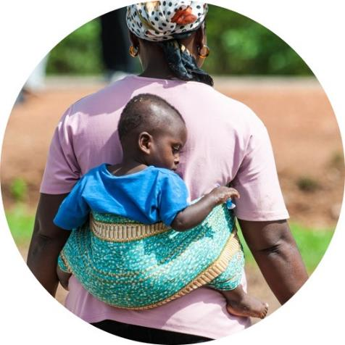
Child Health and Mortality Prevention Surveillance: CHAMPS Saving lives through MITS
MAKING THE DEAD COUNT IN AFRICA
Portia Mutevedzi (PhD)
Senior Director: Impact & Engagement - CHAMPS PO
Emory University
30 Nov 2022

Slide 2
Presentation outline
CHAMPS methods
CHAMPS key findings for action
Using CHAMPS findings to improve maternal deaths & prevent child deaths (Data-to-action)

Slide 3
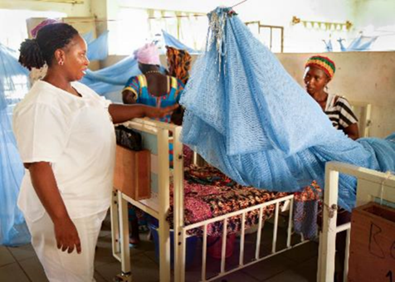
CHAMPS Network – Key Objectives
Track definitive causes of stillbirths and child deaths in high-mortality areas in Africa and South Asia
Using Minimally-Invasive Tissue Sampling (MITS)
Pregnancy surveillance
Produce and disseminate high-quality data to inform policy and public health action
Enable sites to leverage CHAMPS investments to prevent mortality
Interventions
Outbreak response
Special studies

Slide 4
CHAMPS Surveillance Sites
Baliakandi, Bangladesh
Bamako, Mali
Existing sites
Makeni, Sierra Leone
Harar/Kersa, Ethiopia
Contract initiation
Kisumu, Kenya
Quelimane, Mozambique
Manhiça, Mozambique
Soweto, South Africa
Notes:
Nigeria- 2 catchment areas: Cross River state (Calabar) in south and Bauchi state in north
Pakistan- Karachi

Slide 5
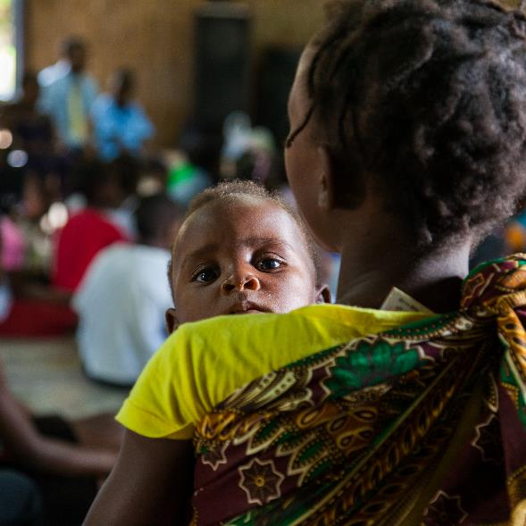
CHAMPS Methods

Slide 6
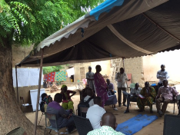
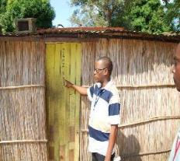
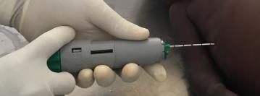
CHAMPS Aims to Deepen Understanding of Causes and Contributors to Under-5 Deaths
Community Engagement
Surveillance
Case Enrollment

Slide 7




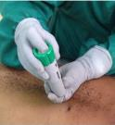

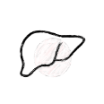





CHAMPS generates causes of death on under-five children using
Minimally Invasive Tissue Sampling, diagnostic testing, clinical records, verbal autopsy
Under-5 deaths, stillbirths detected within 24 hrs
Parental consent for MITS
Blood
CSF
NP/OP swab
Stool
Verbal autopsy interviews
Clinical records abstraction
Liver
Lung
Heart
Brain
Bone Marrow
Photographs
Physical measurements
Placenta
(when available)

Slide 8
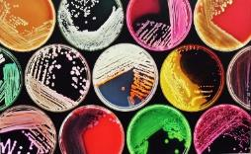
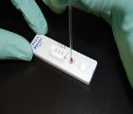
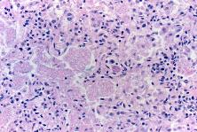
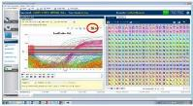
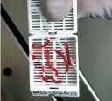
CHAMPS generates causes of death on under-five children using Minimally Invasive Tissue Sampling, diagnostic testing
HIV, TB , malaria testing
Culture
TaqMan Array Cards
Pathology
Notes:
Respiratory- 42
Enteric- 39
Blood/CSF Tier 1- 25
Blood/CSF Tier 2- 27
Pathology- special stains, immunohistochemistry, additional tissue PCR- TELEPATHOLOGY

Slide 9
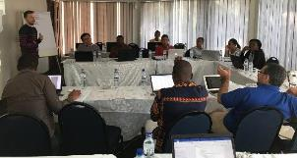
CHAMPS Aims to Deepen Understanding of Causes and Contributors to Under-5 Deaths
Community Engagement
Cause of Death Determination
Surveillance
Case Enrollment

Slide 10

CHAMPS Determination of Cause of Death (DeCoDe)
Demographic Data
Verbal Autopsy
Cause of Death Assignment
ICD-10 and ICD-PM
Clinical Abstraction
Available medical records
DeCoDe Panel
Maternal Abstraction
MITS Collection Data
Anthropometrics
Photographs
Molecular Diagnostics
TAC Results
Pathology Results
Site pathology report
CDC Central Pathology Laboratory: special stains, immunohistochemistry
Whole slide images
Other Diagnostics
Blood and CSF culture
HIV (PCR)
TB (GeneXpert)
Malaria blood smears & RDT

Slide 11
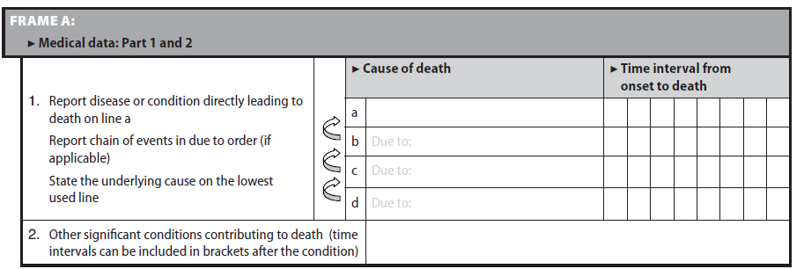
Cause of death assignment following ICD-10 and ICD-PM:
importance of causal chain
Part 1
a
Immediate cause of death
“the disease or complication which directly preceded or directly led to death”
b-c
Morbid causes of death
In the causal chain
d
Underlying cause of death
“disease or injury that initiated the train of events leading directly to death, or circumstances of accident or violence which produced the fatal injury”
Part 2
Significant contributor
Other conditions that contribute to death
Not in the causal chain

Slide 12
CHAMPS DeCoDe Standardizations
Adhere to WHO ICD-10 and ICD-PM guidelines for
determining and classifying perinatal and child deaths
Standardized training provided
Developed diagnosis standards for interpretation of complete CHAMPS data
External quality assurance process

Slide 13
CHAMPS Aims to Deepen Understanding of Causes and Contributors to Under-5 Deaths
Community Engagement
Cause of Death Determination
Surveillance
Case Enrollment

Slide 14
CHAMPS Case Example 1
Female, Stillbirth
  35 week estimated gestation age (by LMP)
  Weight 3.8 kg
Mother- 20 y/o HIV positive on ART (Dx’ d prior to pregnancy)
  Twin pregnancy
  4 ANC visits
Post-mortem HIV, malaria and TB testing negative
Other twin born alive, APGAR 7/8, weight 2000g.
Condition felt to result in stillbirth: Obstructed labor
TAC was positive for Treponema pallidum

Slide 15
CHAMPS Enrolled (n=(9404)
CHAMPS Deaths Enrolled to Date
MITS Completed (n=5303)
DeCoDed (n=3667)
47% of deaths in CHAMPS catchment population undergo MITS
SOURCE: CHAMPS data as of 16 September 2022

Slide 16
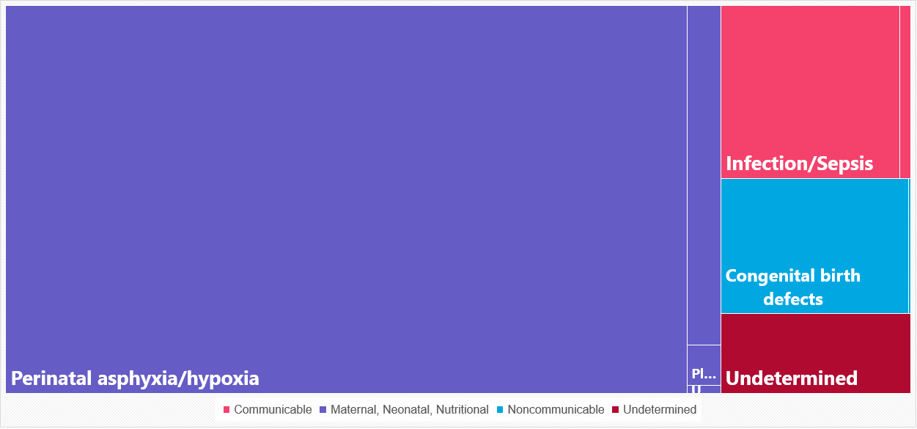
Stillbirth Underlying Cause of Death (n=1294)
83% of stillbirths have only 1 CoD
Syphilis
9%
6%
Other
7%
4%
73%
SOURCE: CHAMPS data as of 16 September 2022
Notes:
56-58% fresh stillbirths

Slide 17
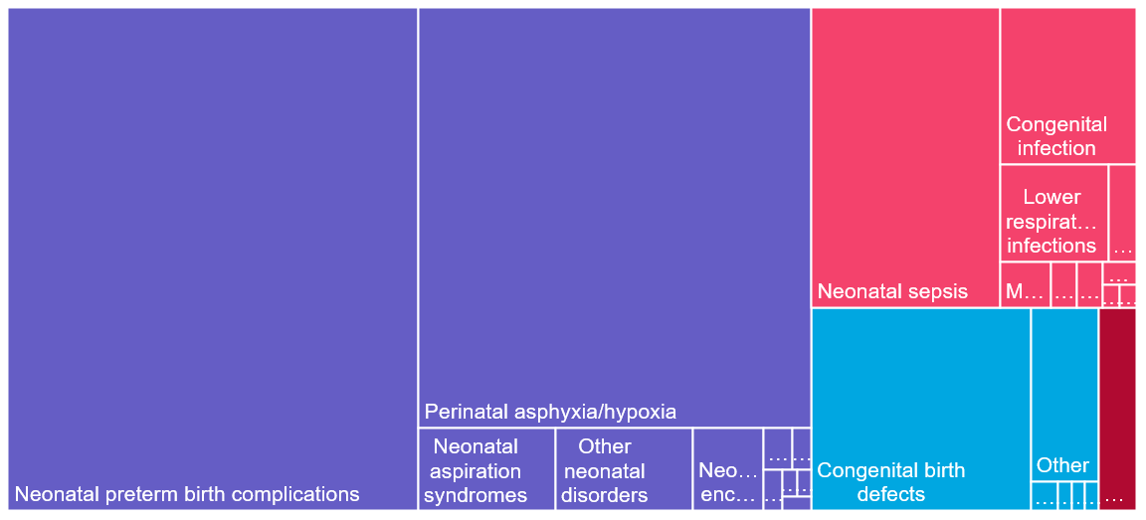


Neonates Underlying Cause of Death (n=1433)
61% have >1 CoD; 35% have 3+
4%
10%
29%
8%
36%
SOURCE: CHAMPS data as of 16 September 2022

Slide 18
Maternal Factors in Stillbirth and Neonatal Deaths
78% of stillbirth and 64% of neonatal deaths determined to be related to a maternal condition
Most common main maternal conditions
  Placental or cord complications (16%)
  Maternal hypertension (14%)
  Obstructed labor or other labor/delivery complications (14%)
  Chorioamnionitis (8%)
  Multiple gestation (5%)
SOURCE: CHAMPS data as of 16 September 2022

Slide 19
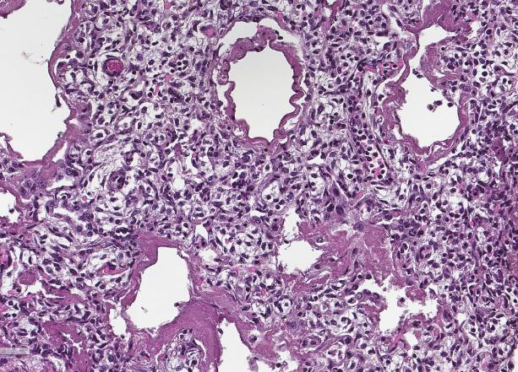
Contribution of Respiratory Distress Syndrome in Neonatal Deaths
Of 1433 neonatal deaths, 43% (n=622) had preterm birth complications in causal chain
  Of preterms, 67% had RDS in causal chain
Presence of hyaline membranes (Figure) used as definitive diagnosis
RDS in causal chain of 29% of all neonatal deaths and an additional 2% (32) of neonatal deaths had RDS as contributory condition
Most hospitals in CHAMPS sites lack needed respiratory equipment and surfactant to support preterm infants
* Arrows indicate hyaline membranes
SOURCE: CHAMPS data as of 16 September 2022
Notes:
Mention surfactant issue. Most facilities in our sites do not have surfactant or other equipment needed.

Slide 20
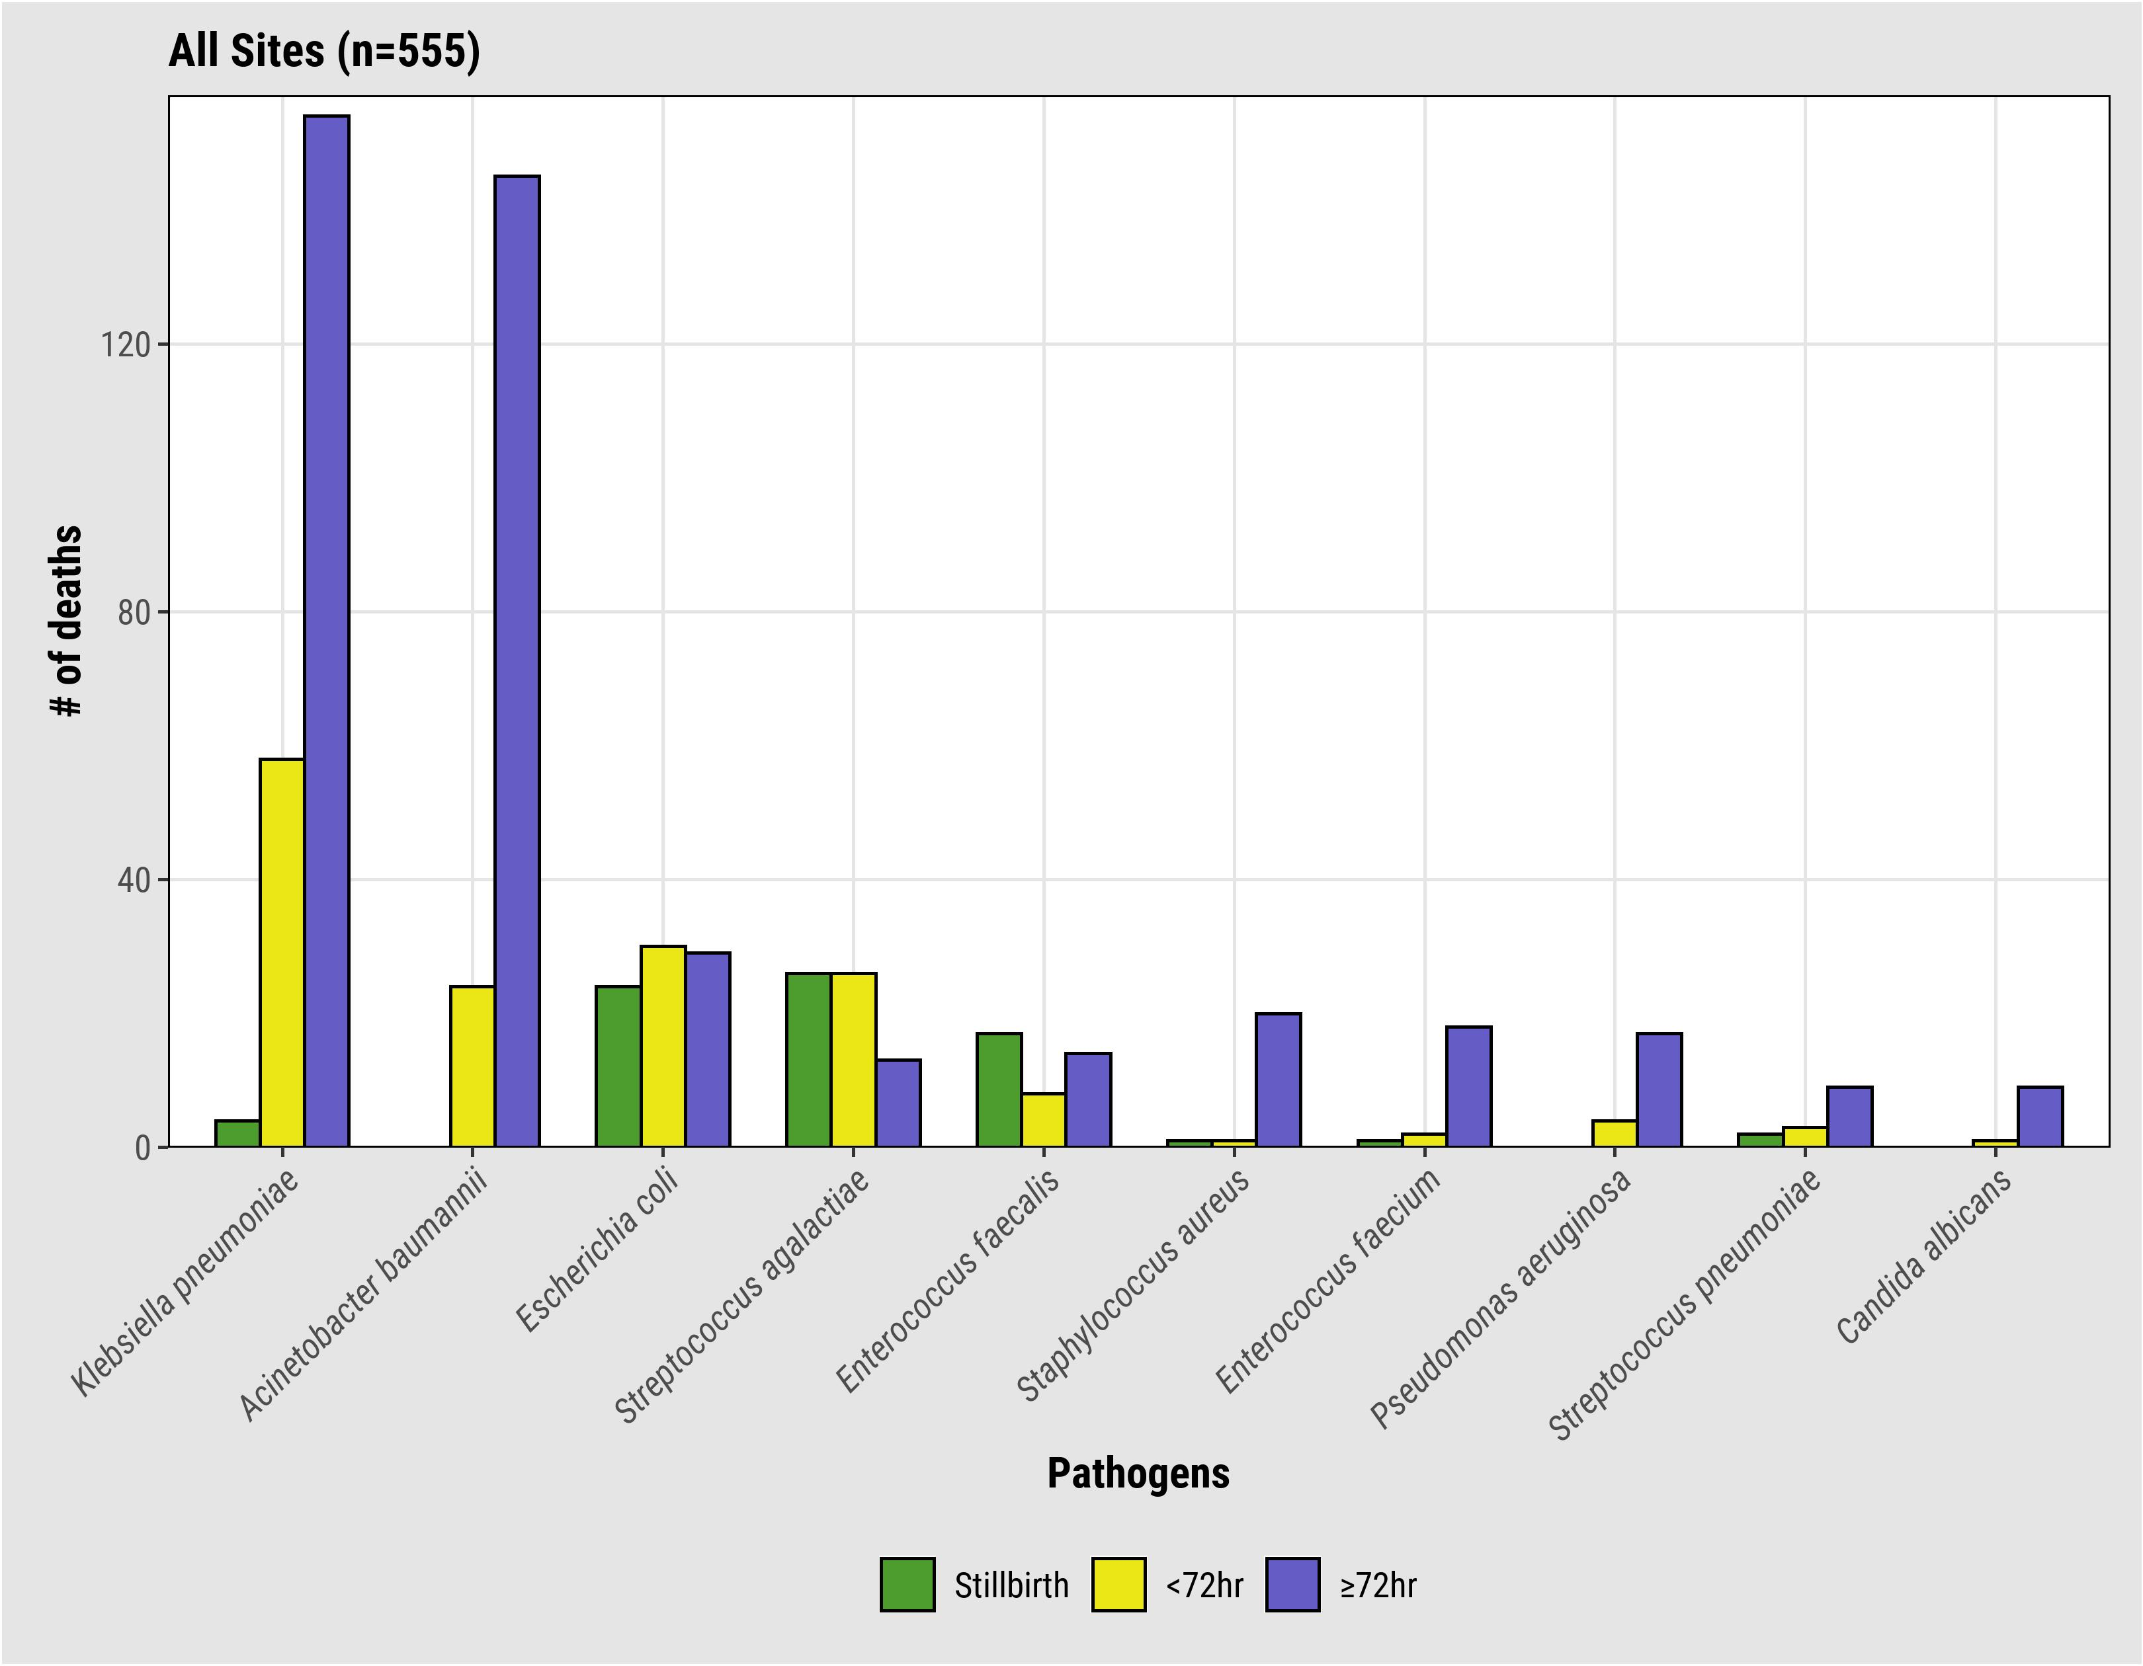
Neonatal Sepsis Etiologies
Klebsiella pneumoniae and Acinetobacter baumannii are the top etiologies in neonatal sepsis deaths
SOURCE: CHAMPS data as of 19 August 2022

Slide 21
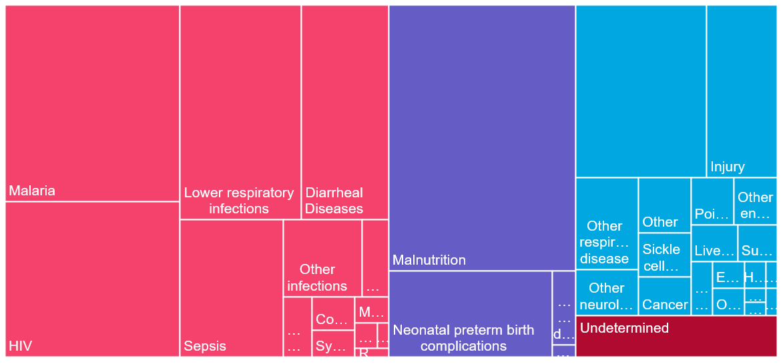
Infant/Child Underlying Cause of Death (n=940)
73% have >1 CoD; 44% have 3+
Congenital birth defects
8%
6%
9%
12%
17%
18%
6%
4%
11%
4%
SOURCE: CHAMPS data as of 16 September 2022

Slide 22
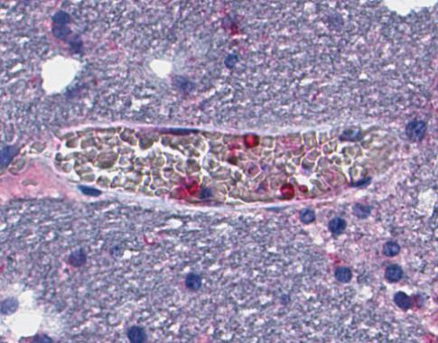
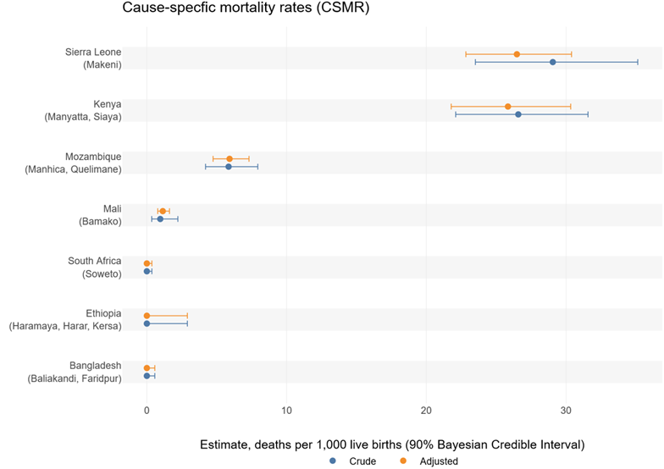
Malaria in U5 Mortality
Age Group | KE (n=262) | MZ (n=156) | SL (n=196) | Total* (n=614)
Infants (n=283) | 33 | 4 | 19 | 56
Child (n=331) | 52 | 22 | 66 | 140
TOTAL n=614 (%) | 85 (32%) | 26 (17%) | 85 (43%) | 196 (32%)
CNS- Malaria IHC (red staining)
No malaria deaths in Bangladesh and South Africa; few (1 and 3, respectively) in Ethiopia and Mali;
No malaria deaths in neonates
SOURCE: CHAMPS data as of 16 September 2022
Notes:
Notes for rate graph:
¹Adjusted for age of the child and season of death.
²Adjusted for location of death.
³Adjusted for age of the child.
⁴No factors met criteria for adjustment.

Slide 23
HIV in CHAMPS: HIV prevention gaps
Of deaths in children 1-59mo (n=926), 11% had HIV in causal chain
  97% of these had other infectious process in causal chain
    Top pathogens included CMV, Klebsiella pneumoniae, S. pneumoniae, Pneumocystis jirovecii and Malaria
  Frequent deficiencies in PMTCT
    Only 20% of children received antiretroviral treatment prophylaxis after delivery
    Only 30% of the mothers received ART during pregnancy
Of deaths in children 1-59 months without HIV infection, 16% have documented HIV exposure (born to HIV positive mother)
CMV inclusion in lung tissue
SOURCE: CHAMPS data as of 22 July 2022

Slide 24
Pneumonia
Pathogen​ | % among all Pneumonia (N=280)​
Gram -​ | ​
*K. pneumoniae​ | 31.4%​
*H. influenzae​ | 10.4%​
*P. aeruginosa​ | 5.4%​
*A. baumanii​ | 5.0%​
Gram +​ | ​
*S. pneumoniae​ | 31.8%​
*S. aureus​ | 9.6%​
Viruses​ | ​
*CMV​ | 13.9%​
*RSV​ | 7.1%​
*Adenovirus​ | 5.0%​
Fungi​ | ​
P. jirovecii​ | 7.9%​
No pathogen​ | 12.5%​
In causal pathway for nearly half (46%) of post-neonatal deaths
  Underlying cause for 9%
  Common immediate or co-morbid cause when underlying cause is malnutrition, HIV, sepsis, congenital defects
Median number of attributed etiologies = 2
No pathogen determined to be causal in only 12.5%
*Shown are pathogens accounting for >5% of pneumonia deaths
SOURCE: CHAMPS data for manuscript in preparation

Slide 25
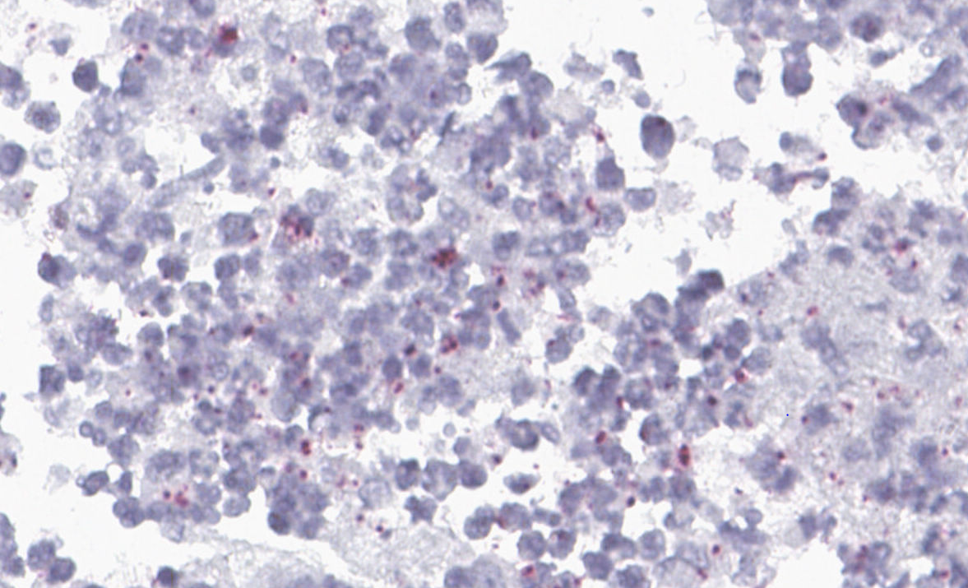
Identifying Unrecognized Burden:
Klebsiella pneumoniae – Detections and in Causal chain
Detected in blood, CSF and/or lung tissue in 30% of all deaths
  Ranges from 11% in stillbirths to 59.6 % in older infants (6 to <12 months)
In causal chain for 14% of all deaths
84% sepsis; 20% meningitis
Not all healthcare-associated
  14% of deaths occurring in hospital
  13% of community deaths
Unexpected finding… reflection of what routine antibiotics don’t address?
Meningoencephalitis with positive immunohistochemistry staining of Klebsiella pneumoniae
SOURCE: CHAMPS data as of 22 July 2022

Slide 26
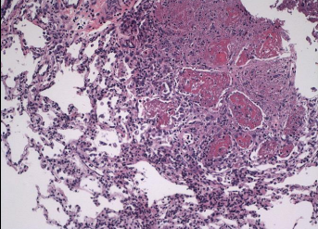
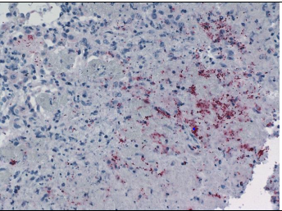
CHAMPS Detects Sentinel events:
Tuberculosis in Infants and Children
1.2% (11/884) of deaths in 1-59mo children attributed to TB
  Mozambique (3), Sierra Leone (2) and South Africa (6)
Four (36%) only diagnosed postmortem
Reported to local public health per CHAMPS routine for notifiable diseases
Follow-up by CHAMPS included:
  Strengthening health education for clinicians and communities and
  Promoting early investigation and treatment for tuberculosis or referral to the next level of care.
Lung- necrotizing granuloma
Lung- immunohistochemical staining for Mycobacterium
SOURCE: CHAMPS data as of 22 July 2022

Slide 27
Moving from Data to Action
Notes:
Title

Slide 28
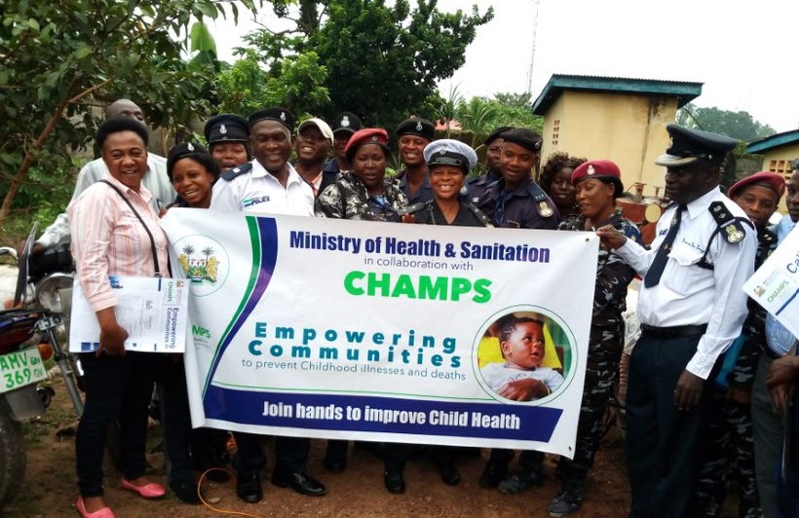
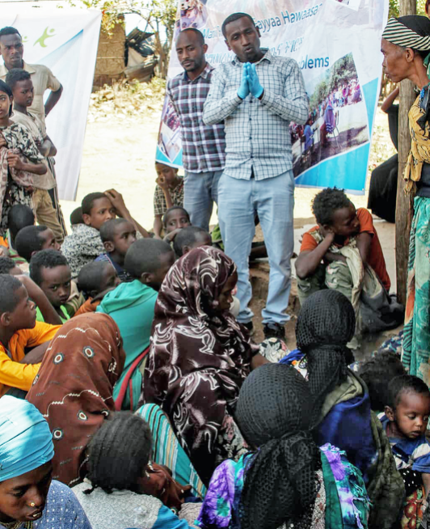
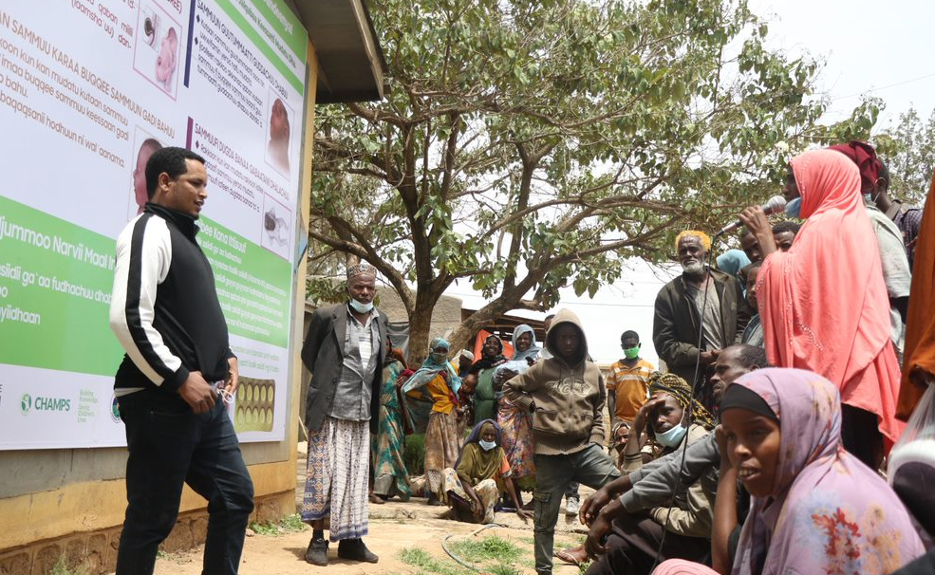
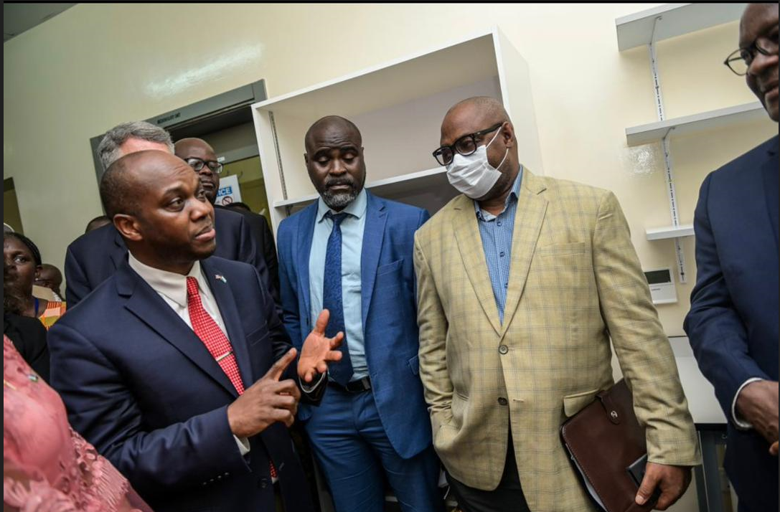
Using CHAMPS Data to Improve Lives of Mothers and Babies
Grief counselling helps bereaved mums to deal with trauma
CHAMPS households are linked to other essential services – social grants, vital documents
Community-Led Interventions for Mothers and Babies (CLIMB)
Data for action: guiding policy & interventions
Notes:
Move data dissemination to before the main focus areas
Why does D2A matter
Change this slide into the story slide of why D2A matters – can use SA example

Slide 29
Key Results Areas for Interventions: Using CHAMPS results to direct mortality prevention efforts

Slide 30
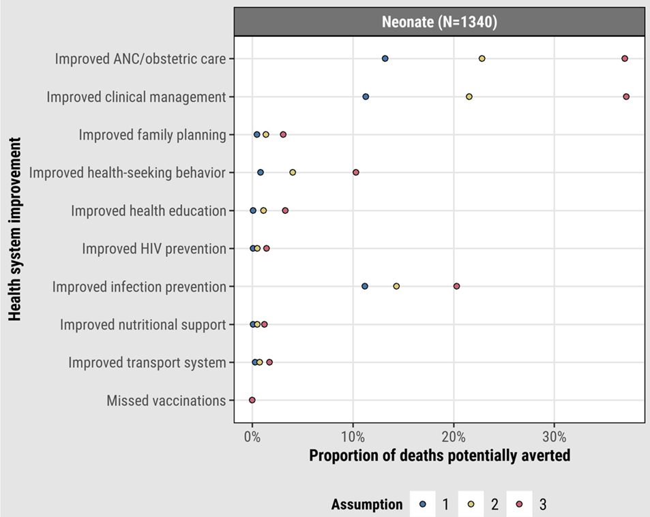
Most Neonatal Deaths Could Have Been Prevented
7 of 10 deaths in CHAMPS determined by DeCoDe panels to have been preventable
  1-2 of 10 preventable in certain circumstances
To prevent neonatal deaths, should focus on improving
  ANC/obstetric care
  Clinical management
  Infection prevention
SOURCE: Madewell Z et all JAMA Network Open in press

Slide 31
Data-to-Action: Improving maternal health and reducing child deaths
Improving demand for, access to and quality of ANC services
  Kenya Quality Model for Health (KQMH) standards in the delivery of MCH services
  Sierra Leonne
  Ethiopia, Kenya, South Africa, Bangladesh – CHAMPS Pregnancy surveillance
Community-Led Interventions for Mothers and Babies (CLIMB) – cross-network – collaborating with community and healthcare leaders to reduce preventable perinatal and maternal deaths in Africa and South Asia through high-quality, respectful healthcare
Neural Tube Defects Surveillance project: Spina bifida and Anencephaly in Ethiopia, folate for prevention – SALT
    Surveillance of folate deficiency & neural tube defects at population level
  Malnutrition interventions among children under 5yrs – South Africa, Mali, Sierra Leonne & Kenya
Notes:
promote high quality respectable care for women (looking for funding)
Explain CLIMB in a bit more detail

Slide 32
More Than Mortality Surveillance:
Using the CHAMPS Platform
COVID-19 RESPONSE
Supported urgent, community-centered responses to COVID-19
  Community educational materials
  Trainings on PPE
  Workshops on containment efforts
Provided COVID-19 testing capacity; Kenya, Ethiopia and Sierra Leone CHAMPS labs designated as national testing hubs for their districts
Launched efforts to look for COVID-19 deaths in adults in two sites; prepared 3 sites for vaccine effectiveness studies
Tested CHAMPS deaths for SARS-CoV-2 - 2% (27/2148) positive
PREGNANCY SURVEILLANCE

Slide 33
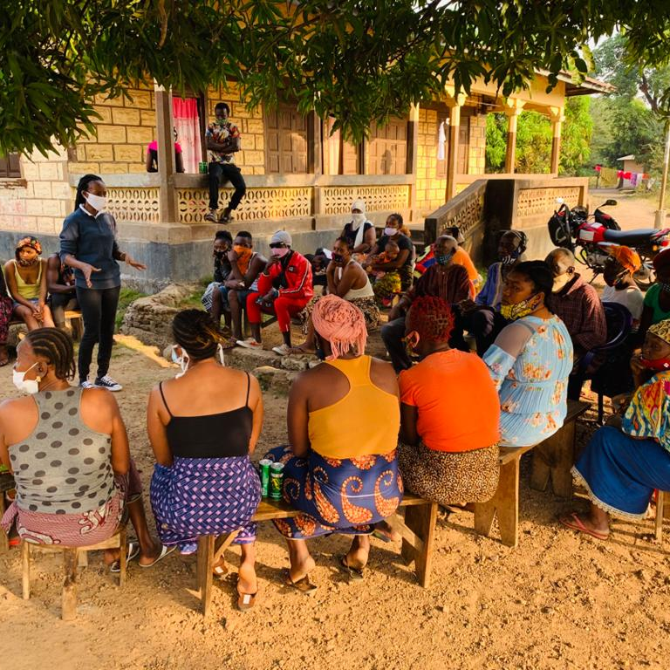
CHAMPS acknowledges the families and communities that make our work possible

